Slide 1

Introduction to Software Engineering (ISE102) Tutorial Week 1

Slide 2
Welcome to 32555 – Fundamentals of Software Development
Your Teaching Team:
Dr. Yining Hu – Subject Coordinator
Dr. Farshid Keivanian – Tutor
Dr. Hasan Khattak – Tutor
Xiaojie (Zoe) Lin – Tutor

Slide 3
Welcome to 32555 – Fundamentals of Software Development
What You’ll Learn:
Fundamentals of software development
Object-Oriented Programming (OOP) using Java or Python
UML modeling & GUI applications
Software testing, collaboration, and version control (Git)
Tools Used: Visual Paradigm, Git, BlueJ / Eclipse / VSCode, Python 3.8+, JavaFX / Tkinter

Slide 4
Week 1 Expectations
Welcome everyone to 32555 – Fundamentals of Software Development. Whether you’ve coded before or this is your first time, this subject is designed to give you the foundations of software engineering using either Python or Java.
We’ll teach you how to think like a developer: analyze user needs, model your solution, write working code, test it, and work in a team using Git.
Please choose either Python or Java this week — you only need to use one language for the rest of the trimester. Labs, quizzes, and assessments will align with your choice.

Slide 5
Week 1 Expectations
By next week, I want you to have your IDE set up, Git configured, and be comfortable with UML tools.
Remember: don't just aim to pass — aim to build something meaningful and reusable for your portfolio.
I’ll be here to support you throughout. Let’s make it a great semester!

Slide 6
Week 1 Expectations
As a student, you are expected to:
Attend weekly 2-hour tutorials (on campus)
Watch online lectures and demos before each lab
Complete all practice quizzes and assignments on time
Communicate professionally via Canvas Inbox
Actively participate in group activities and contribute equally

Slide 7
Week 1 Expectations
Avoid:
Leaving labs or assignments until the last minute
Ignoring Canvas announcements or deadlines
Submitting without proper version control or testing

Slide 8
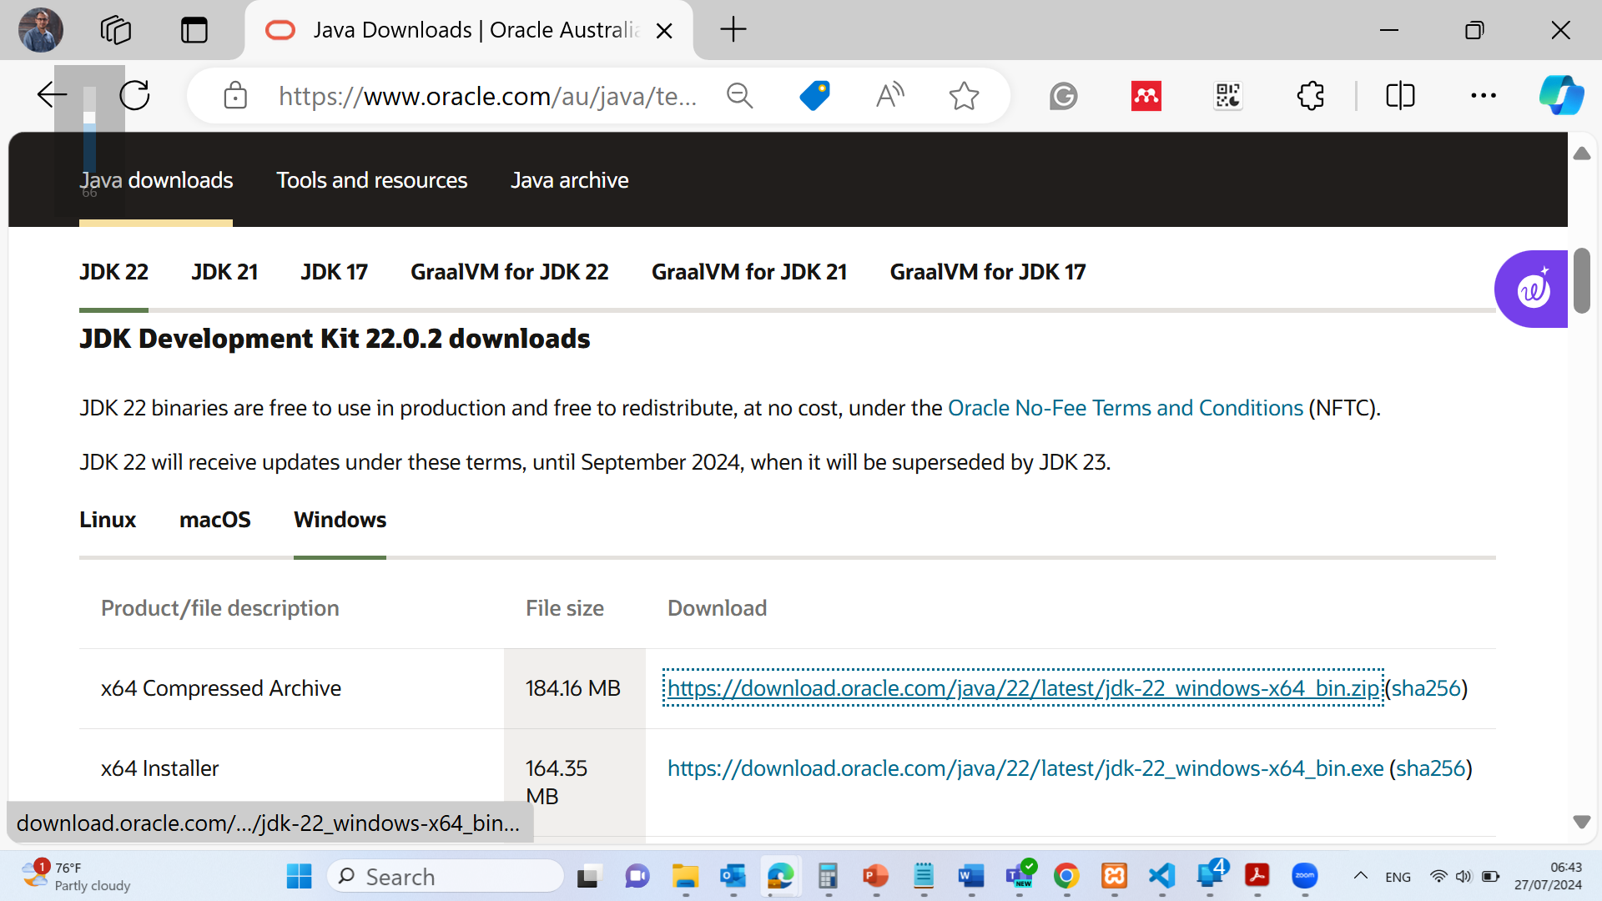
Java Installation:
Download and install the idk package https://www.oracle.com/au/java/technologies/downloads/#jdk22-windows

Slide 9
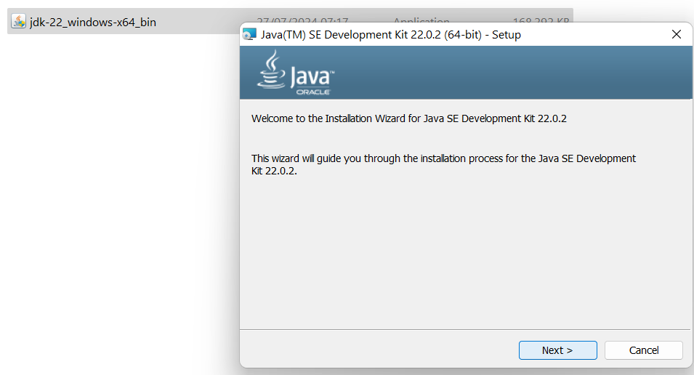
Java Installation:
Download and install the idk package https://www.oracle.com/au/java/technologies/downloads/#jdk22-windows

Slide 10
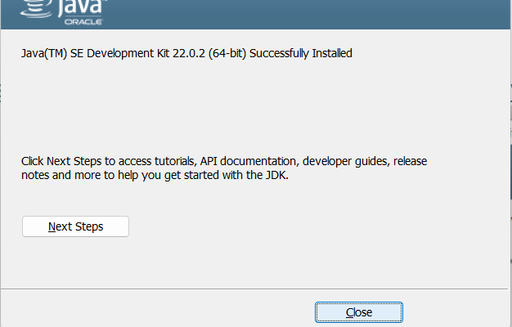
Java Installation:
Download and install the idk package https://www.oracle.com/au/java/technologies/downloads/#jdk22-windows

Slide 11
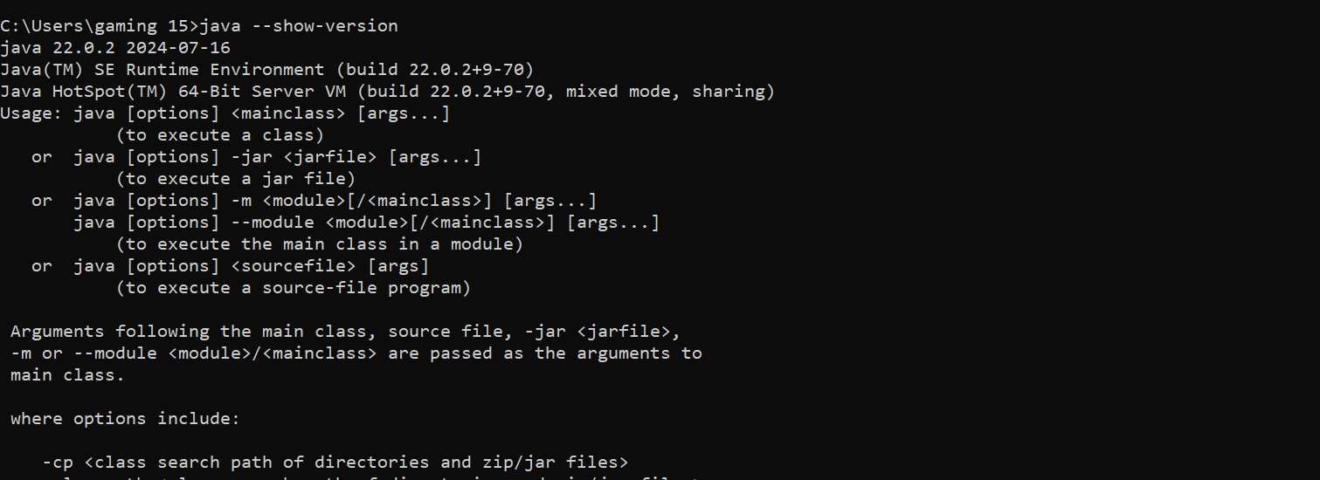
Java Installation:
Command Prompt Windows / Terminal in MAC: java –show-version

Slide 12
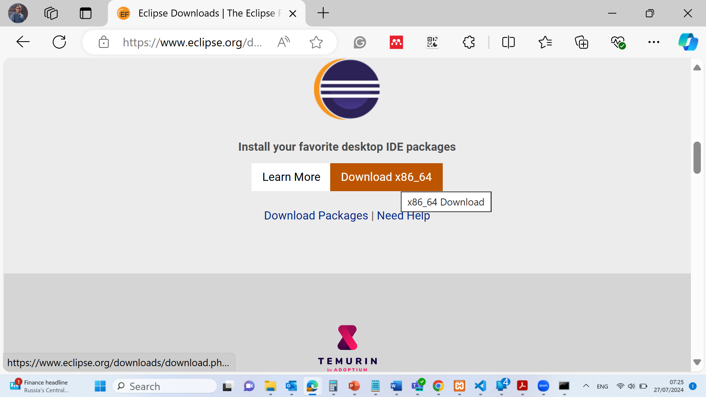
Java Installation:
Download Eclipse Software https://www.eclipse.org/downloads/

Slide 13
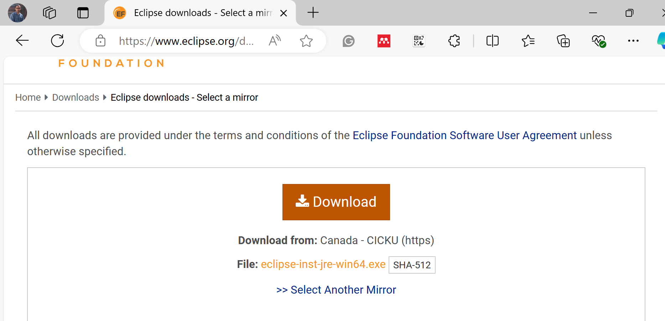
Java Installation:
Download Eclipse Software https://www.eclipse.org/downloads/

Slide 14
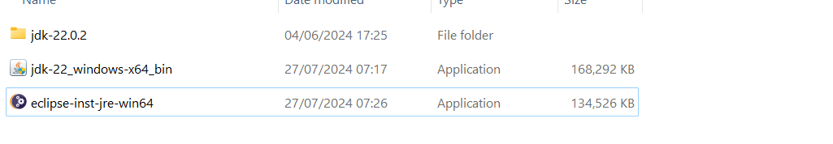
Java Installation:
Install Eclipse Software https://www.eclipse.org/downloads/

Slide 15
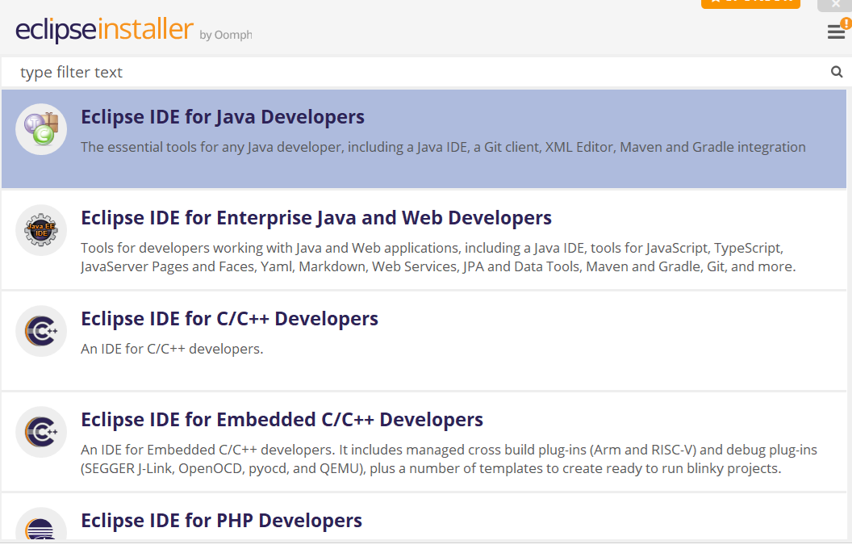
Java Installation:
Install Eclipse Software https://www.eclipse.org/downloads/

Slide 16
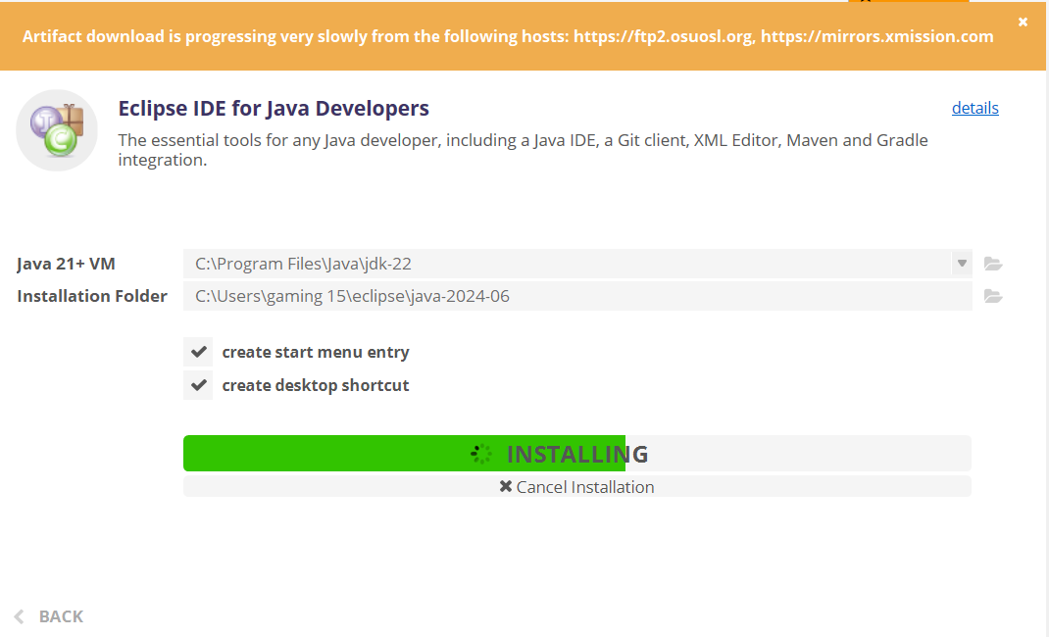
Java Installation:
Install Eclipse Software https://www.eclipse.org/downloads/

Slide 17
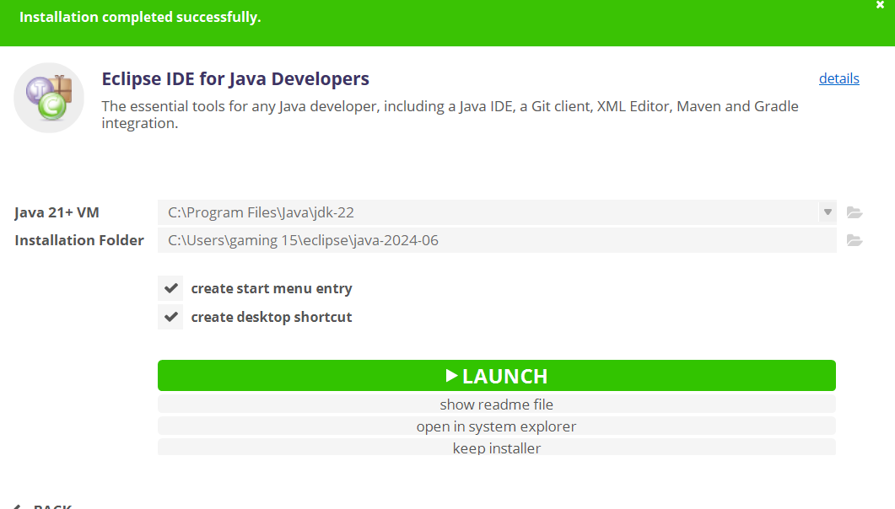
Java Installation:
Install Eclipse Software https://www.eclipse.org/downloads/

Slide 18
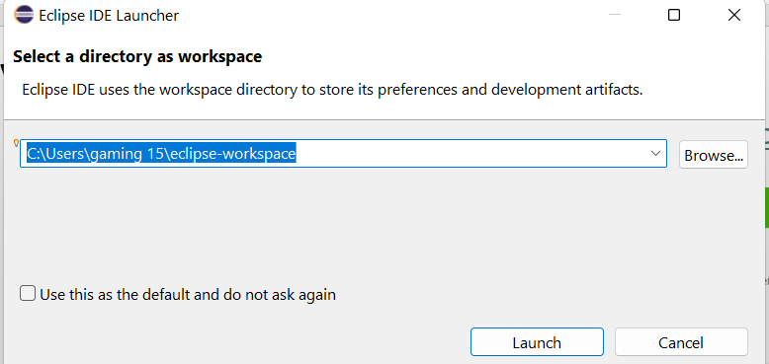
Java Installation:
Install Eclipse Software https://www.eclipse.org/downloads/

Slide 19
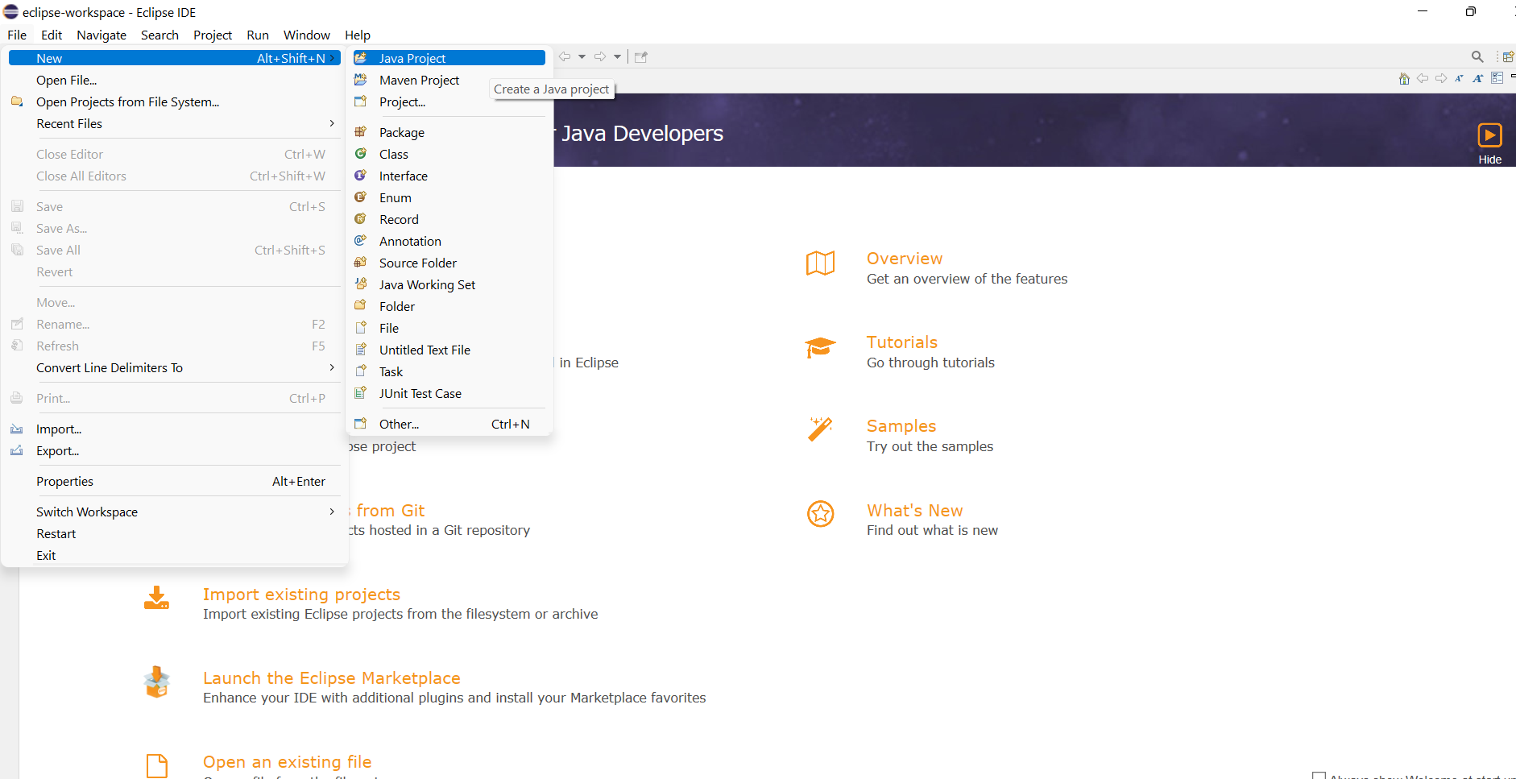
Java Installation:
Install Eclipse Software https://www.eclipse.org/downloads/

Slide 20
For Python Programming
Recommendations:
Use Anaconda if:
You're new to Python/ML
You want a plug-and-play setup with JupyterLab
Use VS Code if:
You're already comfortable with Python and want a more advanced, customizable development workflow
Use Google Colab if:
You want to access your code from anywhere at anytime using your Gmail.

Slide 21
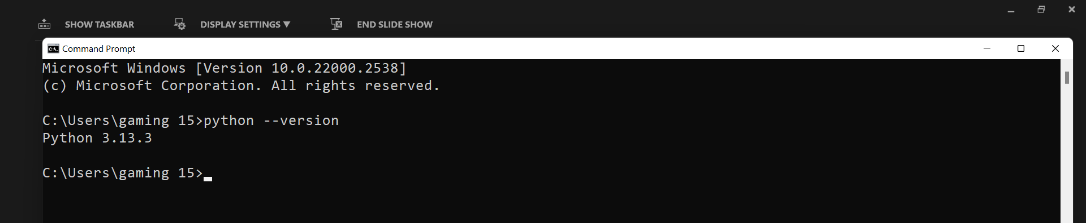
If you use Visual Studio Code
Test in terminal:
python --version
You have Jupyter support in VS Code Make sure you have the Jupyter extension installed
In VS Code → Extensions (Ctrl + Shift + X) → Search for "Jupyter" → Install
Make sure you have the required ML libraries installed, such as:
numpy
pandas
matplotlib
scikit-learn
seaborn (optional but useful)
jupyter
openml (optional for datasets)
Run this in terminal to install them all:
pip install numpy pandas matplotlib scikit-learn seaborn jupyter
You can run .ipynb notebooks in VS Code and execute Python code without issues.

Slide 22
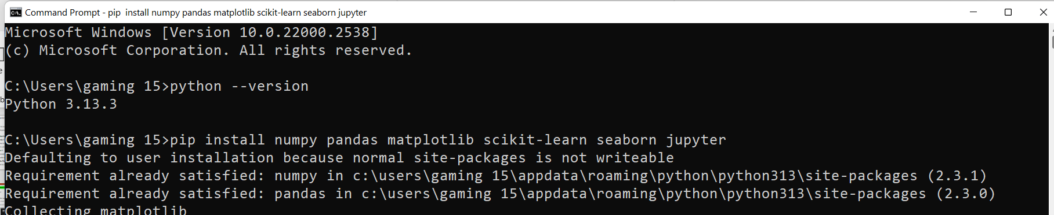
If you use Visual Studio Code
Test in terminal:
python --version
You have Jupyter support in VS Code Make sure you have the Jupyter extension installed
In VS Code → Extensions (Ctrl + Shift + X) → Search for "Jupyter" → Install
Make sure you have the required ML libraries installed, such as:
numpy
pandas
matplotlib
scikit-learn
seaborn (optional but useful)
jupyter
openml (optional for datasets)
Run this in terminal to install them all:
pip install numpy pandas matplotlib scikit-learn seaborn jupyter
You can run .ipynb notebooks in VS Code and execute Python code without issues.

Slide 23
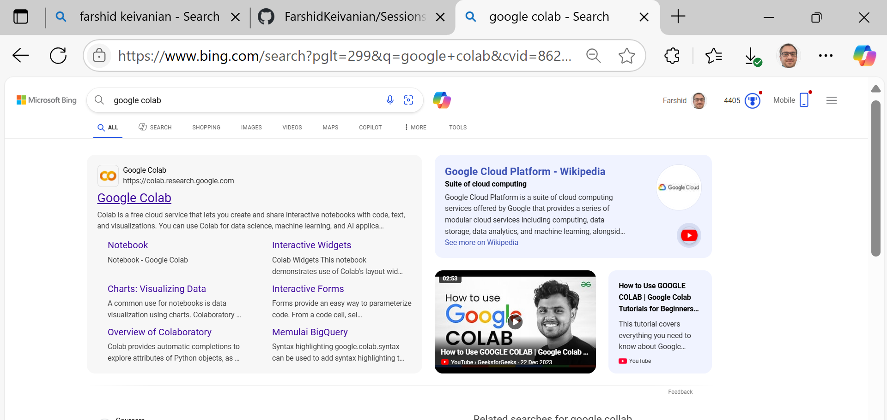
If you use Google Colab

Slide 24
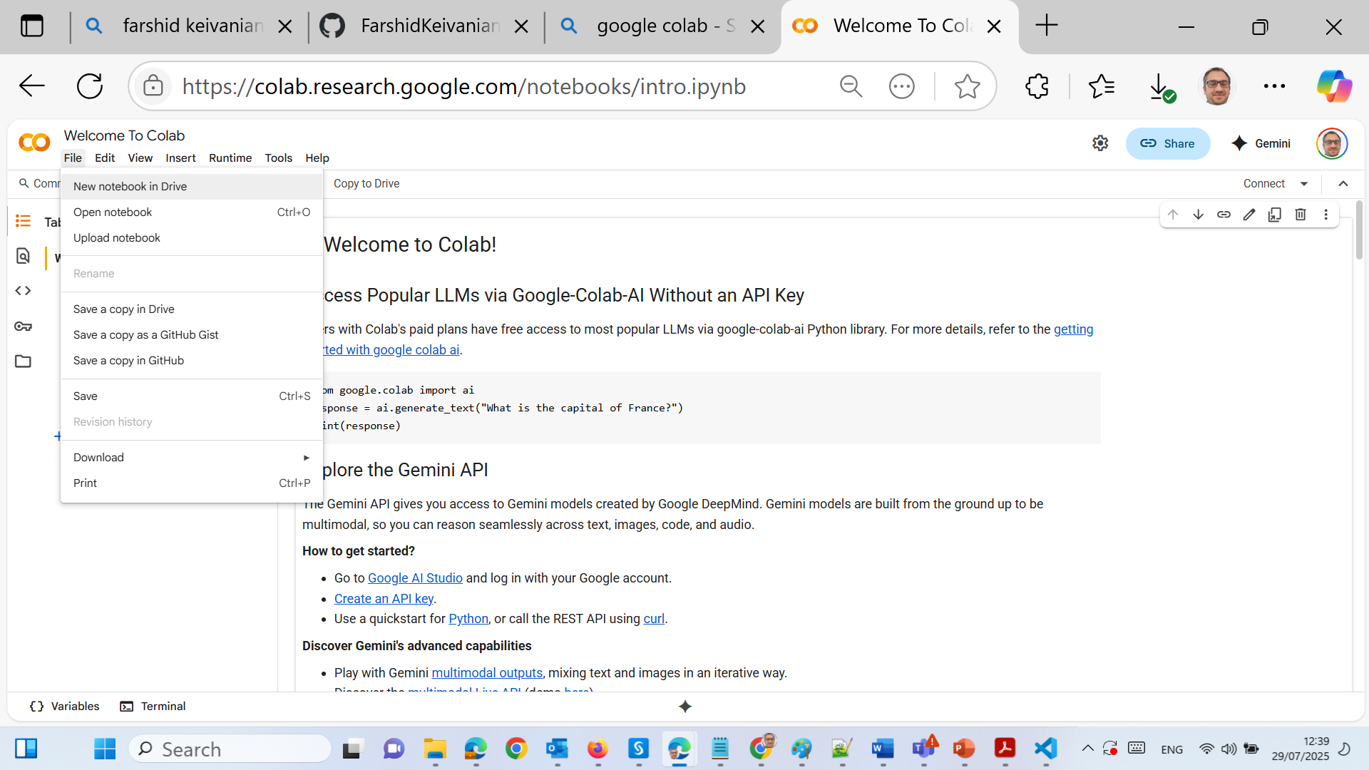
If you use Google Colab

Slide 25
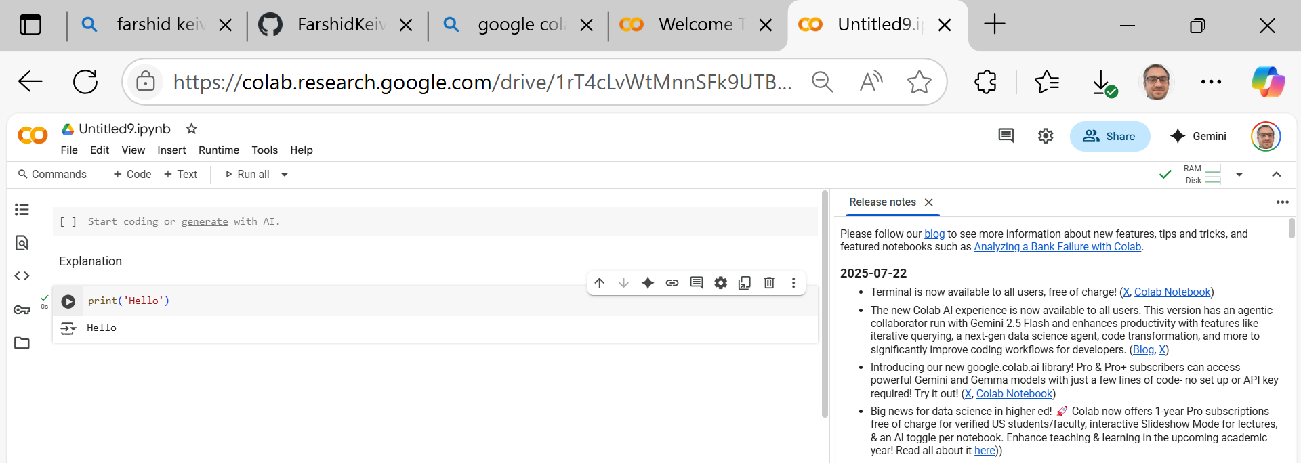
If you use Google Colab

Slide 26
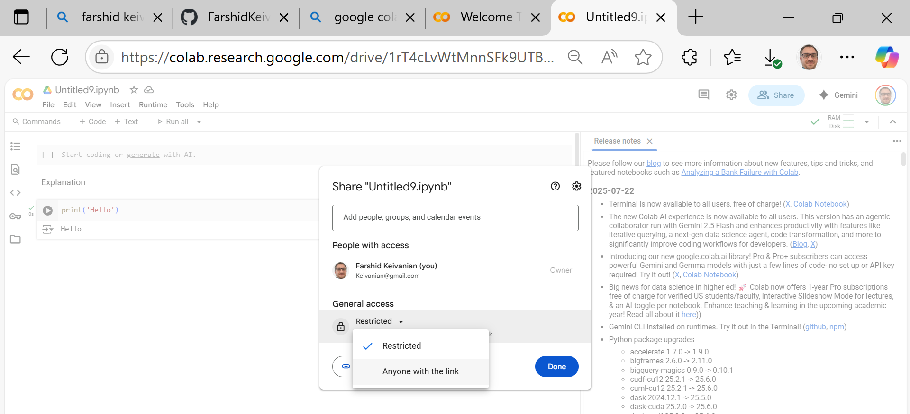
If you use Google Colab

Slide 27
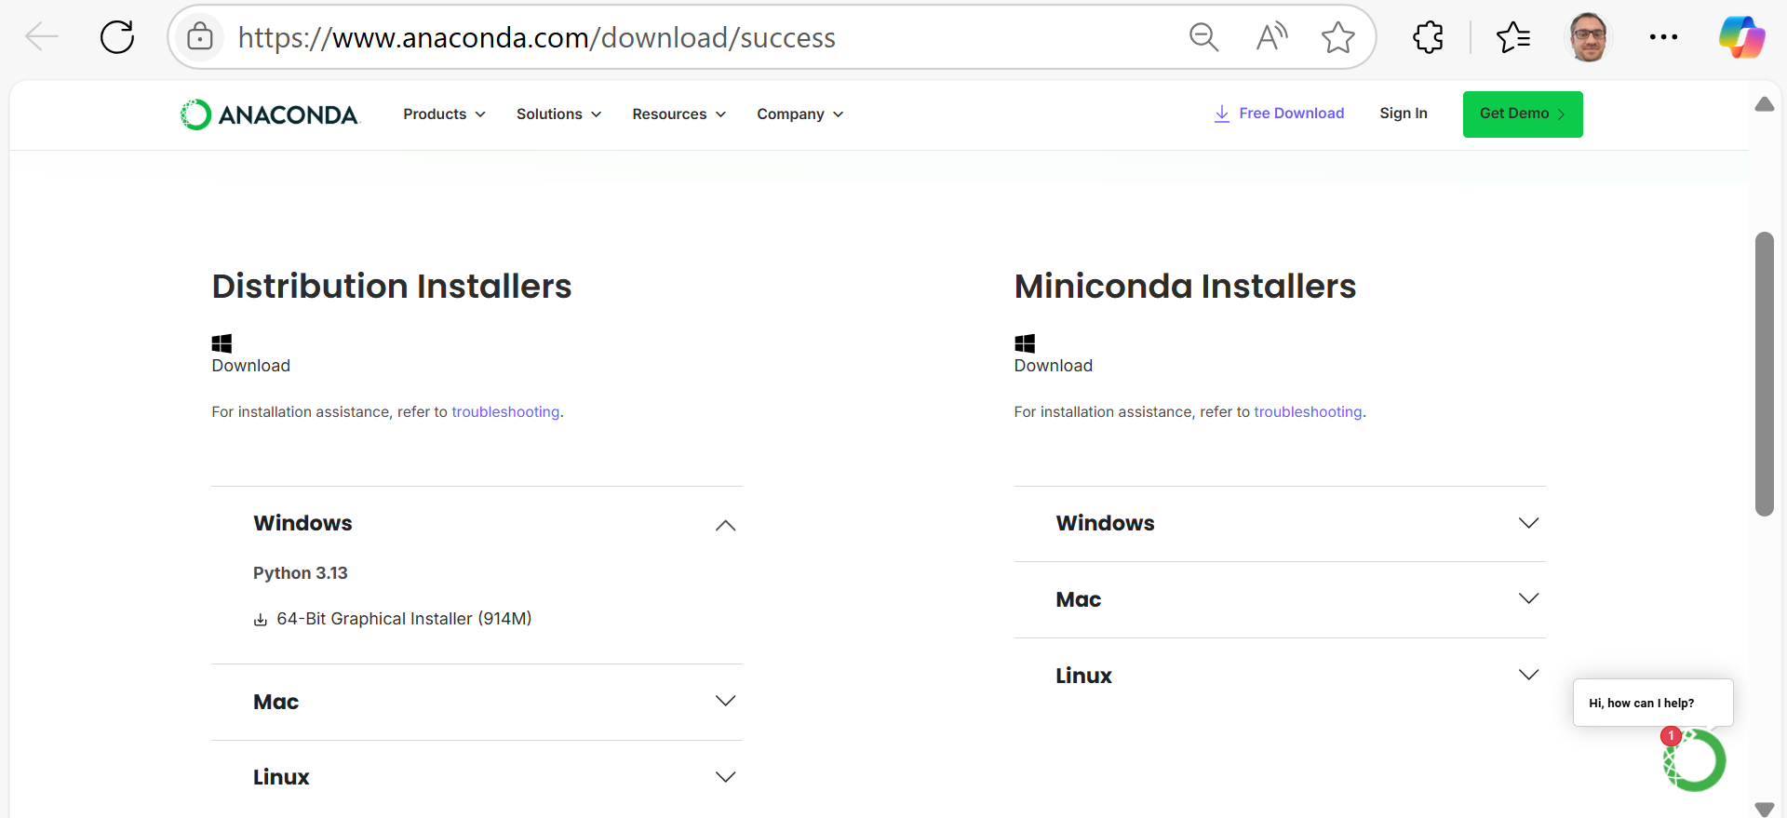
If you use Anaconda – Follow these steps:
Windows/Mac/Linux
Distribution Installers → Windows / Mac / Linux (based on their OS)

Slide 28
If you use Anaconda – Follow these steps:
Launch JupyterLab
From Anaconda Navigator, open JupyterLab.
It will open in a browser.
Create a new Python Notebook.
Write and Run Python Code
Use the grey code cells to write and run Python code.
Output appears below the code block.

Slide 29
Cloud Setup with Google Colab
Log into Google Drive with your Gmail account.
Create or open a Colab Notebook Go to: https://colab.research.google.com Or open from Google Drive > New > More > Colab.
Write and run Python code Use the Runtime menu to run cells.

Slide 30
How to Succeed in 32555
Weekly Routine for Success:
Watch the week’s lecture video
Complete the practice quiz
Attend and participate in your tutorial
Review and reflect on feedback
Contribute to group activities and GitHub commits

Slide 31
How to Succeed in 32555
Pro Tips:
Pick one language (Java or Python) and stick with it
Use UML tools to map your ideas before coding
Use Git for version control from the start
Reach out if you’re stuck — don’t wait until it’s too late!

Slide 32
Key Assessment Dates – Spring 2025
Task | Opens | Due | Weight
Quiz 1: Software Modelling | 9 Sep 5:00 PM | 12 Sep 6:00 PM | 15%
Part 1: Analysis & Design | 18 Aug | 14 Sep 11:59 PM | 15%
Quiz 2: Programming (Java/Python) | 21 Oct 5:00 PM | 24 Oct 6:00 PM | 15%
Part 2: Software Development | 29 Sep | 9 Nov 11:59 PM | 50%
Part 3: Project Showcase | 29 Sep | 7 Nov 11:59 PM | 5%

Slide 33
Week 1 – Requirements Analysis
What are software requirements?
Functional vs. Non-functional requirements
Use Case Diagrams and System Requirements Specs
Introduction to UML: Use Case & Activity Diagrams

Slide 34
Week 1 – Requirements Analysis
Tutorial (Lab 1):
Hands-on activity: Analyze a real-world scenario
Draw a use-case diagram using Draw.io or Visual Paradigm
Discuss requirements with your team

Slide 35
Week 1 – Requirements Analysis
Deliverables This Week:
Complete Week 1 Practice Quiz on Canvas
Submit Lab 1 solution

Slide 36

Happy Learning and Bright Futures Ahead! Dr. Farshid Keivanian Stay Connected: linkedin.com/in/farshid-keivanian github.com/FarshidKeivanian
Education is the most powerful weapon you can use to change the world. — Nelson Mandela

